Slide 1
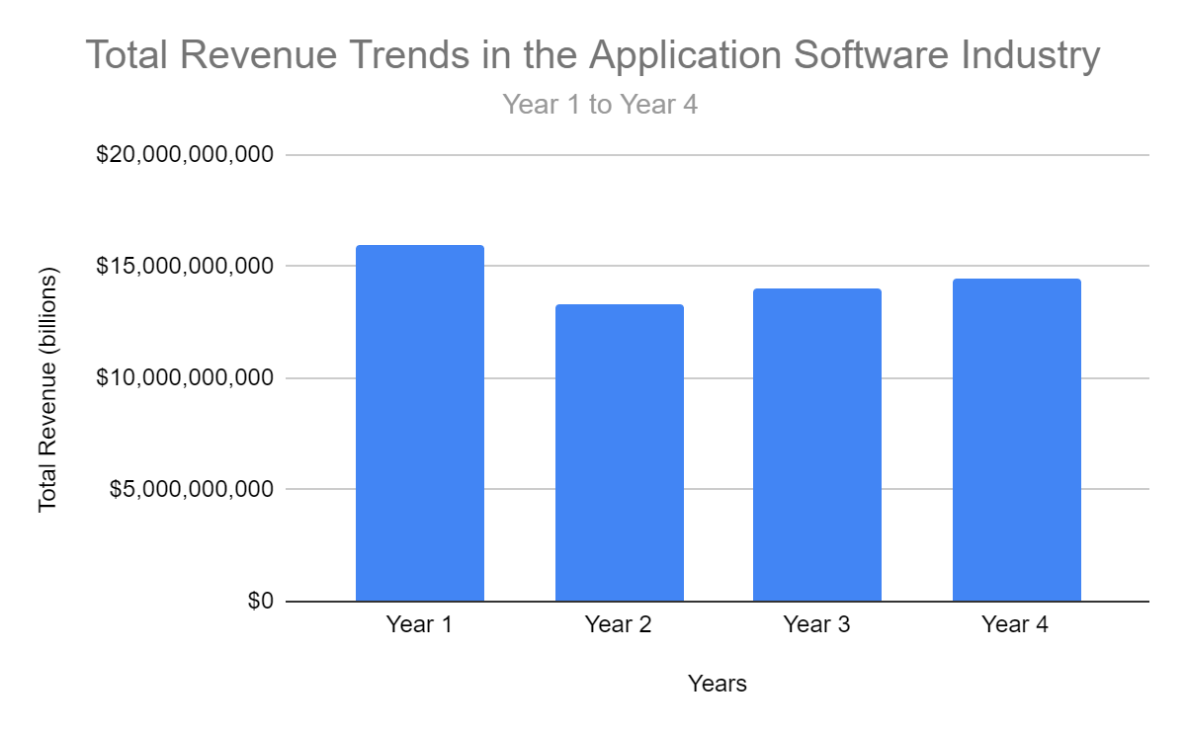
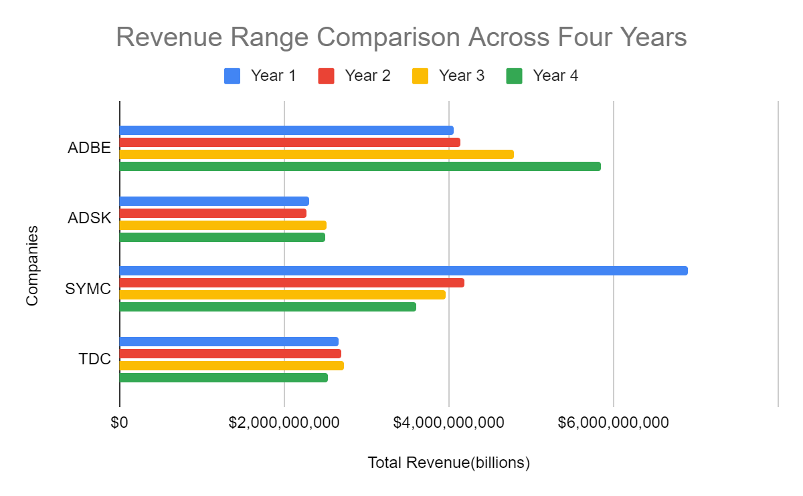
In the trend analysis of total revenue over the four-year period in the Application Software Industry, which company was responsible for the maximum total revenue, and what insights can be derived from this trend analysis?
<visualization or summary statistics used for finding>
Findings:
The overall trend in the Application Software Industry indicated revenue growth, with Year 4 being the most financially successful year collectively.
The total revenue in the Application Software Industry displayed a notable range, from a minimum of $13,295,965,000 in Year 2 to a maximum of $15,938,440,000 in Year 1, signifying a range of approximately $2.64 billion between the lowest and highest revenue years.
While the industry experienced fluctuations, the mean total revenue increased year-over-year, with Year 4 having the highest mean revenue of $3,622,132,500.
Individual companies within the industry demonstrated varying revenue patterns. For instance, Adobe Inc. (ADBE) consistently increased its revenue each year, reflecting a strong growth trend. In contrast, Symantec Corporation (SYMC) and Teradata Corporation (TDC) experienced declining revenues over the period, potentially indicating challenges faced by these companies.
The industry's revenue variance increased over the four years, with Year 4 having the highest variance (133.51%). This suggests that industry-wide revenue fluctuations became more pronounced in Year 4, possibly due to changing market conditions.

Slide 2
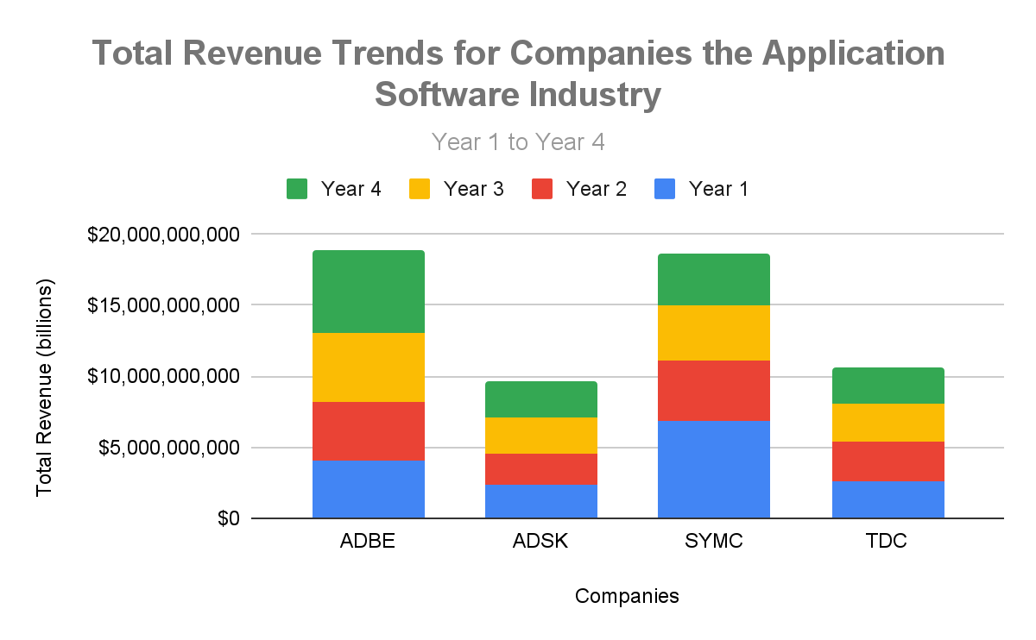
Continued….
<visualization or summary statistics used for finding>
Findings:
Adobe Inc. (ADBE) was responsible for the maximum total revenue in the Application Software Industry over the four-year period
Adobe Inc. (ADBE) demonstrated consistent revenue growth year over year, culminating in the highest revenue among the companies in Year 4, indicating sustained performance.
While Adobe showed significant growth, other companies in the industry, such as Autodesk, Inc. (ADSK), Symantec Corporation (SYMC), and Teradata Corporation (TDC), had varying revenue trends. Some experienced fluctuations, while others saw a decline in revenue during the four-year period.
The performance of individual companies, as observed in the trend analysis, contributed to the overall growth of the industry's total revenue.
.

